Slide 1
Dynamic Adaptive Optimization: Recovering from Hardware Errors and Software Crashes in a Distributed Virtual Machine
Ike Nassi
(Technical collaborator: David P. Reed)
Adjunct Prof UCSC/CSE
formerly CTO and Founder, TidalScale
(TidalScale now lives at HPE)
TTI / Vanguard
Resilience and Reliability Conference
Chapel Hill, NC
March 5-7, 2024

Slide 2
Motivations for this talk
What if:
Recovery from ~90% of all hardware errors could be automatically and non-disruptively handled?
What if:
When the OS crashes (and it will) it can reboot itself automatically not in many minutes, but in seconds?
What if:
This can be accomplished without any special hardware?
What if:
No changes to ANY software were required?

Slide 3
Goals for this talk
Surprise:
All of this is possible
This talk address many failures, both hardware and software

Slide 4
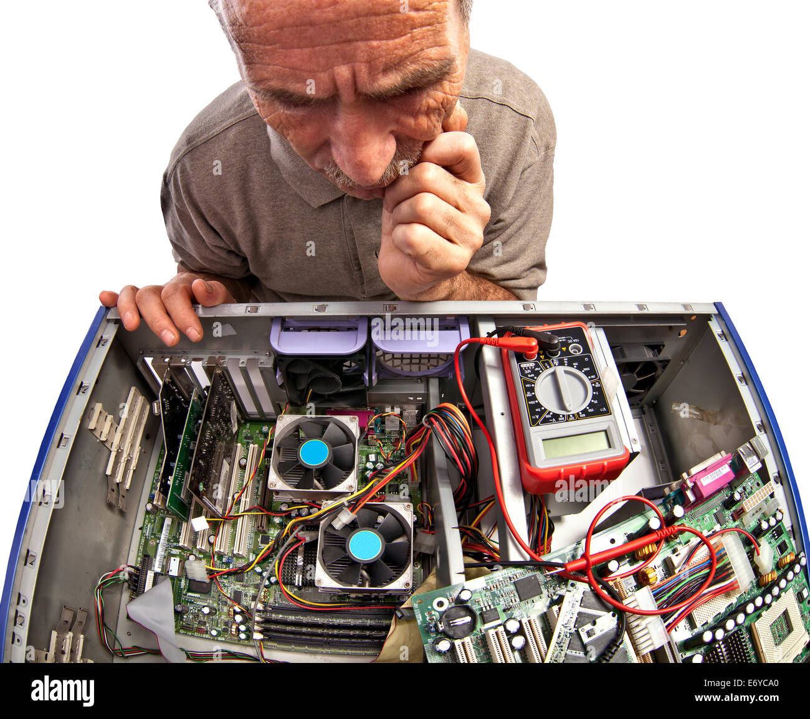
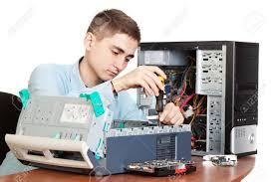
Not Brand New, But to Review:
Hardware can fail. We all know this. But,
Most hardware failures can be mitigated using redundant hardware. We (also) know this. But,
We can now do this transparently with respect to application software that’s running. We (sort of) know this, but people forget. But,
We can now do this transparently to systems software!
(You may have heard this from me before)

Slide 5
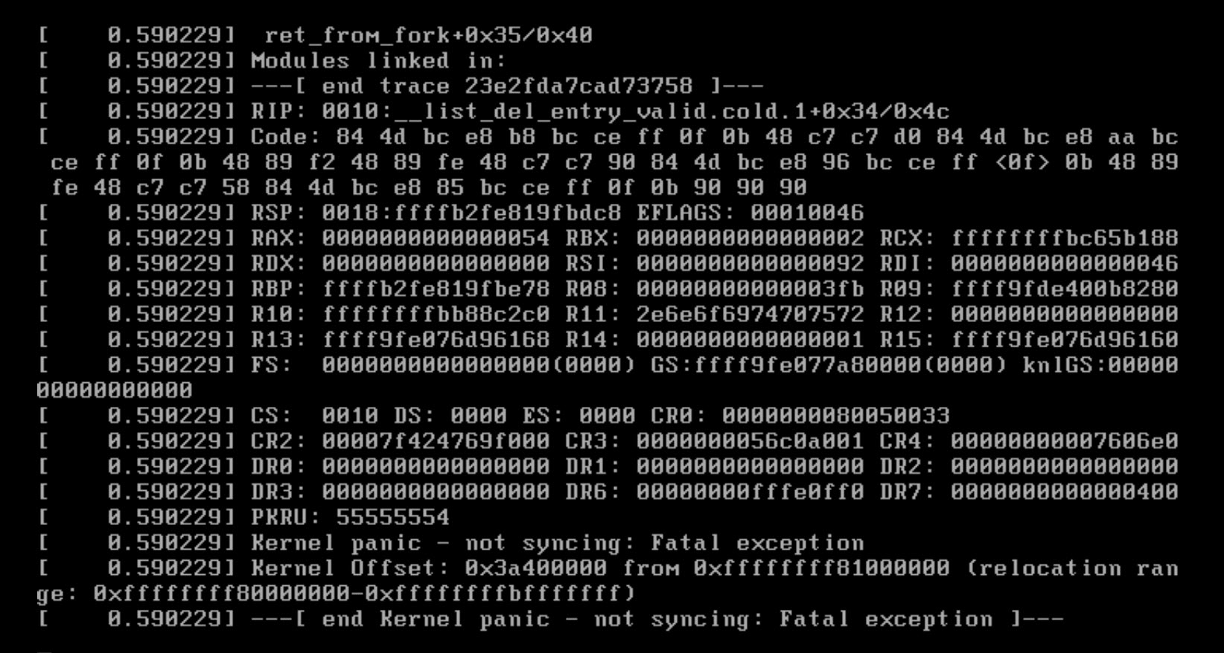
Operating Systems can FAIL!

Slide 6
Operating Systems can FAIL!
Thankfully, it’s rare. We know this. But,
When an OS fails, it takes quite a lot of time to bring it back online.
Because the OS tests and clears memory, and
Reloads a lot of data from storage. But,
How much of do we really need to do, and how quickly can we do it? Can we do it safely?
Answers: Not much, very quickly, and yes, safely.

Slide 7
The Key Insight: Use A Distributed Virtual Machine
Create a highly reliable and resilient distributed virtual machine architecture (DVM)
Some said it couldn’t be done.
Alan Kay (strong believer in software virtual machines):
“Ike: You’re only realizing this NOW?”

Slide 8
Why use a DVM?
Dynamically Scale, up or down
Simplify – No software modifications
Dynamically Self Optimizing using Machine Learning
No New Infrastructure
Highly Reliable

Slide 9
Traditional virtualization…
Virtual Machines sharing a server
Virtual Machine
Virtual Machine
Virtual Machine
Virtual Machine
Virtual Machine
Virtual Machine
This is not the model!
Physical Machine

Slide 10
Distributed Virtualization Machine
Virtual Machine sharing multiple servers
Virtual Machine
This is the model
Physical Machine
Physical Machine
Physical Machine
Physical Machine
Physical Machine
Physical Machine

Slide 11
What is a DVM?
A DVM aggregates an entire cluster, i.e. all the processors, all the memory, all the disks, and all the local storage and presents the entire set as a single virtual server, e.g., a very large motherboard
This virtual machine runs across a cluster of closely cooperating, dedicated, homogeneous, off-the-shelf (commodity) servers, connected by standard LAN
Virtual resources (processors, memory, I/O) can migrate from server to server and are then automatically rebound to physical resources.
The DVM boots a single standard operating system (RedHat, SUSE, Oracle Linux, Centos, etc.)
Implication: No changes to any OS, compiler, libraries or applications are required

Slide 12
What it looks like
Application
Database
Operating System
Exit
Hyper
Kernel
Hyper
Kernel
Hyper
Kernel
Hyper
Kernel
Hyper
Kernel
…
HW
HW
HW
HW
HW

Slide 13
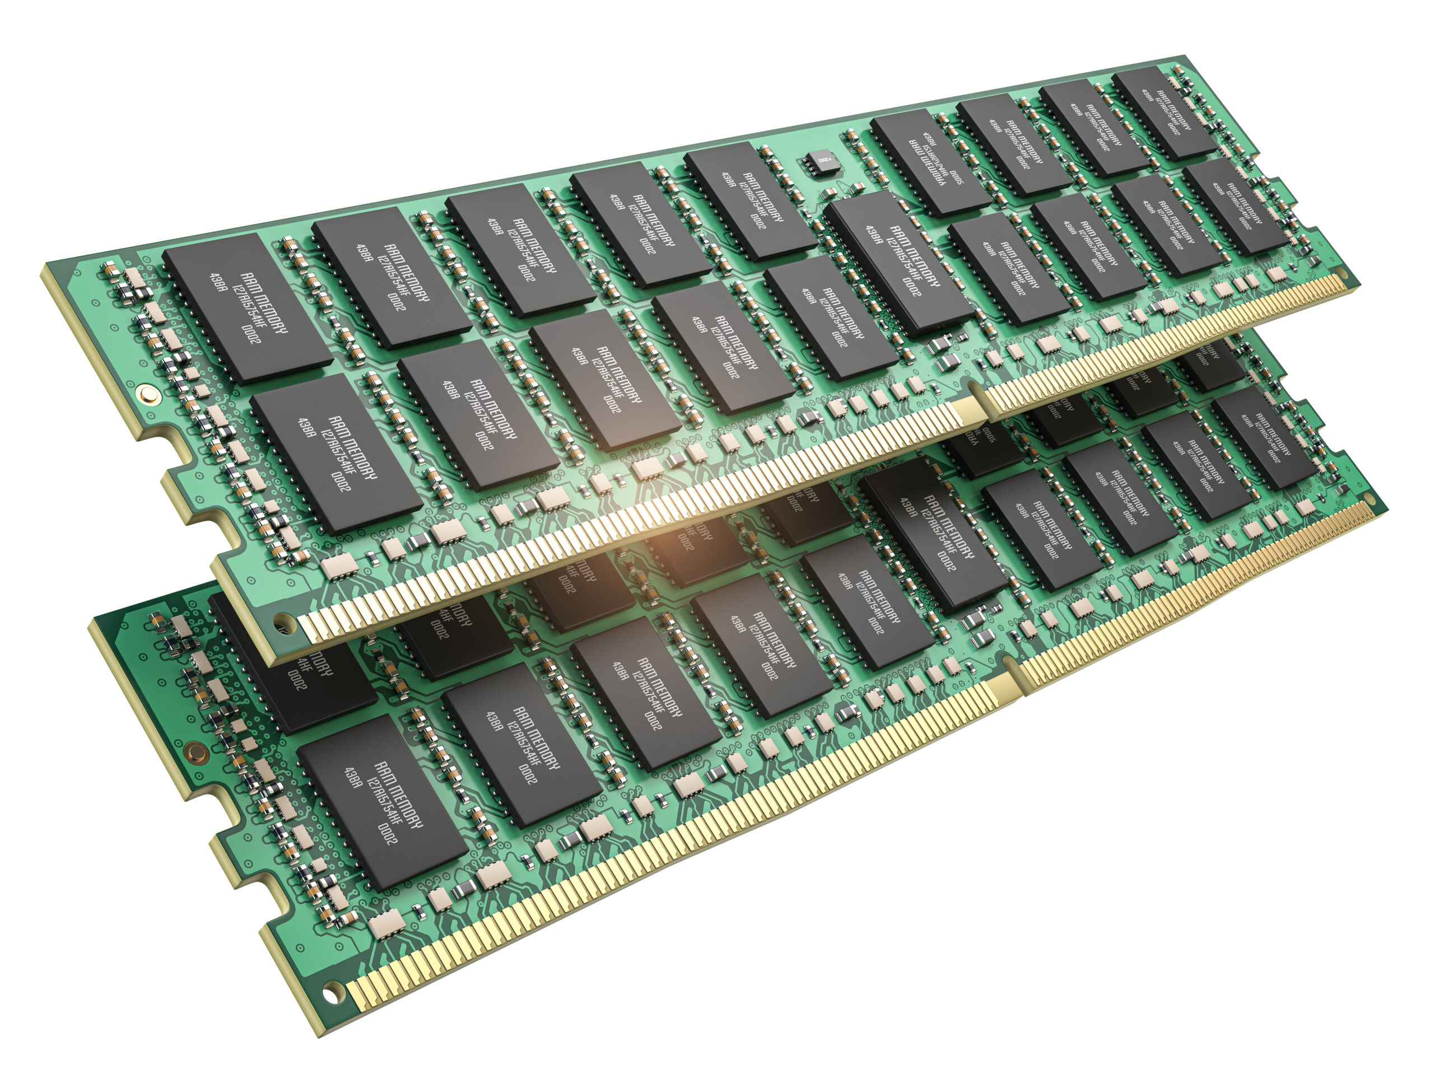
Thanks For the Memories – but what exactly do we mean by memory?
An application process sees virtual memory, NOT physical memory.
Real physical memory (RPM) is packaged on memory chips, often on dual inline memory modules (DIMMs). This is what you buy when you buy memory.
RPM DIMMS are installed on physical server motherboards.
Is this what the OS sees? Not necessarily.
The OS sees what the DVM want it to see, and the DVM can tightly control this. We call the memory that’s visible to the OS Guest Physical Memory (GPM).
The DVM controls the mapping between GPM and RPM.

Slide 14
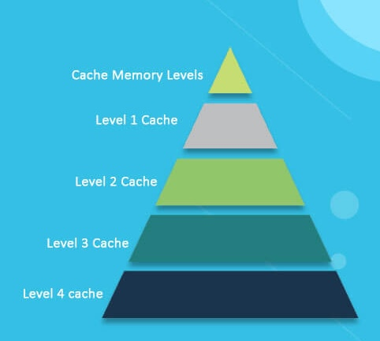
The DVM Becomes an All-Cache Architecture
Modern caches are hierarchical: L1, L2, L3. DVM technology effectively introduces a software-based L4.
All the memory on the motherboard is treated like any other cache (L4) except for one thing: the L4 cache is all the memory on the motherboards and is therefore HUGE, generally ~0.5TB - 2TB per server times ~5 servers = ~10TB! It becomes a cache-only system.

Slide 15
Page Mapping
By setting up the page tables in advance, the OS handles the first level page table mapping invisibly to the process as it does today
By setting up the page tables in advance, the DVM handles the second level page table mapping invisibly to the OS

Slide 16
Multi-level Dynamic Address Translation
Process Virtual Address
Guest Physical Address
First
Level
Page
Table
Second
Level
Page
Table
Then
Guest Physical Address
Real Physical Address
Therefore, page address mapping is handled by using two levels of dynamic address translation supported in most modern microprocessors. A process’s VM maps to GPM, which in turn maps to RPM at hardware speed.

Slide 17
Rethinking DRAM from the SW Point of View
Where is the DRAM? Answer: It depends on your point of view:
From the host point of view (i.e. HW), the physical motherboard.
From the guest point of view (i.e. OS), it’s also on a motherboard, but that motherboard is virtual.
From the guest point of view, “physical” DRAM is actually a cache of host memory.
In other words, guest DRAM is a cache. It’s an all-cache design.
Guest
Application Software
Application Software
vCPU
Operating System
Operating System
vCPU
RAM
vCPU
RAM
vCPU
RAM
RAM
RAM
RAM
RAM
Virtual
Resources
RAM
CPU
CPU
RAM
CPU
RAM
RAM
CPU
RAM
RAM
RAM
RAM
HyperKernel
Physical
Resources
RAM
HyperKernel
HyperKernel
HyperKernel
Dedicated private interconnect
Host
Notes:
Under the covers, TidalScale uses machine learning to automatically co-locate compute entity with the resources it needs. And just like ordinary virtualization it does all of this transparently - the OS and applications have no idea they aren't running on hardware....

Slide 18
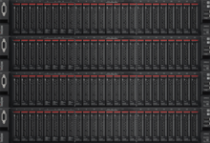
Under the Hood
One software-defined server
Application Software
vCPU
Operating System
Software-Defined Servers
vCPU
RAM
vCPU
RAM
vCPU
I/O
RAM
I/O
RAM
I/O
I/O
Multiple physical servers
CPU
CPU
RAM
CPU
RAM
I/O
Bare Metal Servers
CPU
RAM
I/O
RAM
I/O
Inverse-Hypervisor
I/O
Inverse-Hypervisor
Server 4
Inverse-Hypervisor
Server 3
Inverse-Hypervisor
Server 2
Server 1

Slide 19
Under The Hood (move the definition of memory?)
Memory page migration
Application Software
vCPU
Operating System
vCPU
RAM
vCPU
RAM
vCPU
I/O
Uses 2 levels of hardware based dynamic address translation
Migrates vCPUs and memory transparently to the guest OS
Dynamically and automatically load balances
Self-optimizing using ML
No central control
RAM
I/O
RAM
I/O
I/O
CPU
CPU
RAM
CPU
RAM
I/O
CPU
RAM
I/O
RAM
I/O
Inverse-Hypervisor
I/O
Inverse-Hypervisor
Server 4
Inverse-Hypervisor
Server 3
Inverse-Hypervisor
Server 2
Server 1

Slide 20
Under The Hood (or move the processor?)
Virtual CPU migration
Application Software
vCPU
Operating System
vCPU
RAM
vCPU
RAM
vCPU
I/O
Uses 2 levels of hardware based dynamic address translation
Migrates vCPUs and memory transparently to the guest OS
Dynamically and automatically load balances
Self-optimizing using ML
No central control
RAM
I/O
RAM
I/O
I/O
CPU
CPU
RAM
CPU
RAM
I/O
CPU
RAM
I/O
RAM
I/O
Inverse-Hypervisor
I/O
Inverse-Hypervisor
Server 4
Inverse-Hypervisor
Server 3
Inverse-Hypervisor
Server 2
Server 1

Slide 21
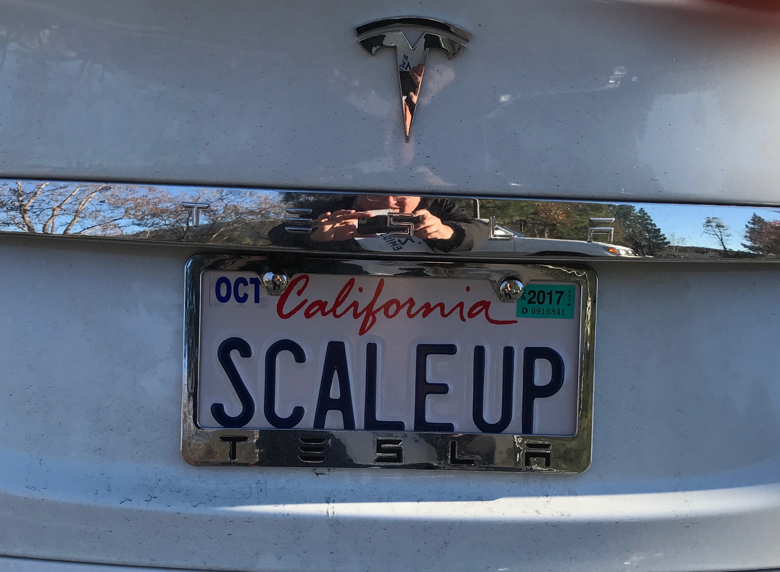
Scale Up or Out? Best of Both Worlds
 | Scale Up | Scale Out | DVM
Software Simplicity | ✔ | ✗ | ✔
Hardware Cost | ✗ | ✔ | ✔

Slide 22
Summary of DVM Technology
The virtual machine aggregates the processors, all the memory, all the storage, all the Ethernets (except for a private interconnect that the DVM treats more as a system bus than a network).
The DVM treats the resources as virtual and mobile. The DVM hyperkernel binds the virtual resources to physical resources, dynamically, as needed, on demand.
There is no master node and no shared state in the hyperkernel. DVM managemant is distributed. Therefore, no single point of failure.
The DVM uses hardware virtualization extensions. Modern hardware has two levels of page tables to translate virtual to physical address: the OS uses the first level, the hyperkernel manage the second, invisibly to the OS.
Processor migration is fast!
Memory is always strongly cache coherent. There can be multiple copies of read only pages across the cluster. On a page write, the hyperkernel does the necessary page invalidation, TLB management, etc. Copy on write is supported. Intel store order is preserved.
The DVM hyperkernel sits between the OS and the hardware.
The DVM is completely agnostic. It looks like hardware to the OS.

Slide 23
Reliability What happens if there is a hardware failure on a single node? Does it bring down the entire cluster?

Slide 24
Insights
Virtual resources can migrate; therefore, we might be able to exploit redundancy using migration
Motherboards have extensive telemetry (they track temperature, DRAM errors, network errors, and more)
Existing OS’s rarely make use of this data.
The DVM can track error trends (e.g. is the DRAM error rate increasing on some DIMM? Is the temperature rising indicating a potential fan failure?)
The DVM can proactively respond when thresholds are exceeded

Slide 26
Optimization Philosophy Based on ML
Guiding Principles:
Machines operate faster than humans. So let them.
Performance is dominated by the (largely unpredictable) pattern of access between processors and memory
The hyperkernel observes, adjusts, analyzes and adapts
Our goal was to build-in intelligence and machine-learning into the hyperkernel to automatically and dynamically monitor and optimize performance through introspection
This leads us to a model in which the DVM can track threads and working set locality

Slide 27
Fast Recovery

Slide 28
First, some background
At boot time, Linux, as an example, clears all memory, reloads the OS, and loads application programs from disk (or over the network).
It can take 30 minutes or more to boot a 1 TB DRAM server to recover, not counting getting the applications back online.
But is it really necessary?
If you guessed “No” you’re correct!
As we just saw, a DVM uses two levels of dynamic address translation. We’ll now use this.

Slide 29
Second, be lazy
Mark the second level page tables with a special code that indicates they must contain zeros, even if they currently don’t.
Only when you need a MBZ page does it need to contain zeros. In other words, zero it on demand.

Slide 30
Storage Replica Table is stored in RPM
 | Storage Replica Table
Stable Storage Addresses | Physical Memory Address | Guest Physical Memory Address
(14, 0x3274) | 0x123456 | 0x235698
(12, 0x1456) | 0x743297 | 0x189543
… | … | …
… | … | …
… | … | …

Slide 31
The SRT must always be consistent
The SRT is not addressable by the OS
Modern HW has a mode to interrupt on all I/O and certain page table updates.
The DVM marks pages as dirty when updated
Page table updates also update the SRT
All disk writes from memory update the SRT
All disk reads to RPM and GPM update the SRT

Slide 32
How this helps
When the OS panics, it reboots. But the DVM does not need to.
The SRT is preserved in memory. (The Guest OS doesn’t even know it exists and can’t address it.)
The contents of RPM are preserved.
On boot, the OS starts reading from disk, but (guess what?) in most cases the pages are already present in RPM, so just re-map. Fake the reads from disk.
The system only reads from disk those pages not already represented in the SRT

Slide 33
Therefore:
Many fewer pages need to be read from stable storage in the normal case
Often, memory pages do not need to be zero-ed
So, system restart happens very quickly

Slide 34
Summary: benefits of a DVM
Highly scalable
No customization is required
Uses standard commodity hardware and software
Self-optimizing (not covered here)
Highly reliable
Often optimizes SW licensing costs (just pay for what you need, when you need it).
Recover quickly from OS panics
Can be deployed on-premise or in the cloud

Slide 35
Summary of what’s new
It’s important to rethink some fundamental assumptions (counter-factual thinking)
Complete OS and application compatibility is possible
Performance (trust me, it’s good; sometimes better than bare HW)
Reliability/High availability is definitely achievable
Supported many deployment options (it ran at AWS, Oracle Cloud, IBM Cloud)
But wait: There’s more!

Slide 36
Thought Experiment
What if you had a server with no processors, only memory?
Might be cheap, slow, static memory rather than DRAM ($$)
Might even be an array of SSDs that is made to look like memory
Anticipates Disaggregated Memory
(aka Memory Appliances)!!
(This was done over a weekend, with performance testing on an industry standard benchmark.)

Slide 37
References
Gordon Bell: “This is the way all servers will be built in the future”
Programming an Application When Memory Size Is No Longer A Constraint, IEEE Computer, August 2017
Revisiting Scalable Coherent Shared Memory, Bell and Nassi, IEEE Computer, Special Issue: Outlook 2018, January 2018
Scalable Computing Systems for Future Smart Cities, IET Smart Cities 2022;1–2

